Slide 1


Azure IaaS – Infrastructure as a Service
Ing. Gabriel O. Zabal
gabriel@zconsulting.com.ar
@GZabal

Slide 2
Agenda
What’s really Azure?
Virtual Machines
Virtual Networks

Slide 3
What’s really Azure?
Notes:
Slide Objectives:
Explain how Azure helps developers to refocus on their applications.
Speaker Notes:
Before we discuss about specifics, let’s refocus on what you care about – your application/service.
Azure is taking a application-centric approach and brings tools and services to support DevOps scenarios.

Slide 4

Hardware + Software +Automation + Apps
Notes:
Slide Objective:
Introduce different virtual machine sizes.
Speaker Notes:
http://azure.microsoft.com/en-us/pricing/details/virtual-machines/

Slide 5
22 DataCenters (24 total)
Hyper-V based virtualization platform
2 x Amazon AWS / 6 x Google DC Regions
Fastest growing ecosystem (Evolution, Automation, Apps, Partners) +-
Biggest VM Size (G-Series)
SSD I/O Performance
South Brasil location (Argentina proximity) -> New DC

Slide 6

Talking about cloud
IaaS
PaaS
SaaS
Applications
You manage
Applications
Applications
You manage
Data
Data
Data
Runtime
Runtime
Runtime
Managed by vendor
Middleware
Middleware
Middleware
Managed by vendor
O/S
O/S
O/S
Virtualization
Managed by vendor
Virtualization
Virtualization
Servers
Servers
Servers
Storage
Storage
Storage
Networking
Networking
Networking

Slide 7
Virtual Machines

Slide 8
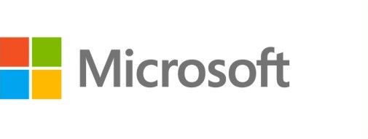



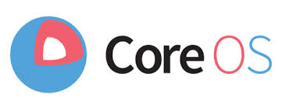

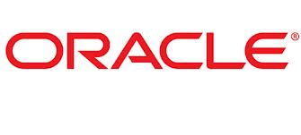
Azure Virtual Machines
Launch Windows Server and Linux in minutes
Scale from 1 to 1000s of VM Instances
Save money with per-minute billing
Open and extensible
Notes:
Slide Objectives:
High-level selling points of virtual machines.
Speaker Notes:
Both Linux and Windows are supported. It’s important to reiterate on this as many developers are still not aware of this.
Mention scaling at enterprise level using DSC, Puppet or Chef.
Emphasize on the openness – we are not forcing your to lock on Microsoft technologies. Instead, Azure is more open than ever. You can leverage your existing skills, tools and services, and Azure is providing more and more first-class supports for them.

Slide 9


Provisioning VM
Getting Started
Select Image and VM Size
New Disk Persisted in Storage
Windows Server
Management Portal
Boot VM from New Disk
Linux
>_
General Purpose
Basic
Standard
Optimized Compute
Performance Optimized
Network Optimized
Scripting
(Windows, Linux and Mac)
Cloud
REST API
Notes:
Slide Objective:
Explain workflow for provisioning VMs in the cloud
Speaker Notes:
You have three methods of starting this process: Build a VM from the portal, from the command line OR programmatically calling the REST API.
Once your choice of provisioning is made you will need to select the image and instance size to start from.
The newly created disk will be stored in blob storage and your machine will boot.

Slide 10

















VM Gallery
A collection of prebuilt images for various workloads
Windows Server 2012 R2
Ubuntu Server 14.04 LTS
CentOS 6.5
SUSE Linux
Enterprise Server
openSUSE 13.1
Oracle Linux 6.4.0.0.0
SQL Server 2014 Standard
Oracle Database 11g R2
SharePoint Server Farm
Microsoft Dynamics
GP 2013
Zulu 8
BizTalk Server 2013
SAP HANA
Developer Edition
Puppet Enterprise 3.2.3
Barracuda Web Application
Oracle WebLogic
Server 12.1.2
Visual Studio Ultimate 2013
Windows 8.1 Enterprise
Notes:
Slide Objective:
Explain a wide variety of images that you can choose from.
Speaker Notes:
First of all, you can choose from different Windows Servers and a variety of Linux implementations. [Click]
As well as pre-built images for different flavors of SQL Database and Oracle databases. [Click]
You can also choose from a number of first-party and certified third-party images for various application servers and infrastructural components. [Click]
And last but not least, if you are a MSDN subscriber, you also have access to Visual Studio images and client Windows systems such as Windows 7 and Windows 8.1 for your DevTest purposes.

Slide 11
Virtual Machine Sizes
General Purpose compute: Basic
General Purpose compute: Standard
Optimized Compute
Performance Optimized
Network Optimized
Notes:
Slide Objective:
Introduce different virtual machine sizes.
Speaker Notes:
http://azure.microsoft.com/en-us/pricing/details/virtual-machines/

Slide 12
Scale-up options
Highest value
Largest scale-up
A
D
G
N
DV2
Highest value
Most memory fastest CPUs
GPU-enabled virtual machines
SSD Storage Fast CPUs
>80,000 IOPs
Premium Storage
New generation of D family VMs
35% faster than D
Intel E5-2673 v3 CPUs
NVIDIA GPUs
Remote visualization
Compute-intensive + RDMA
Largest virtual machines Fastest storage in the public cloud

Slide 13
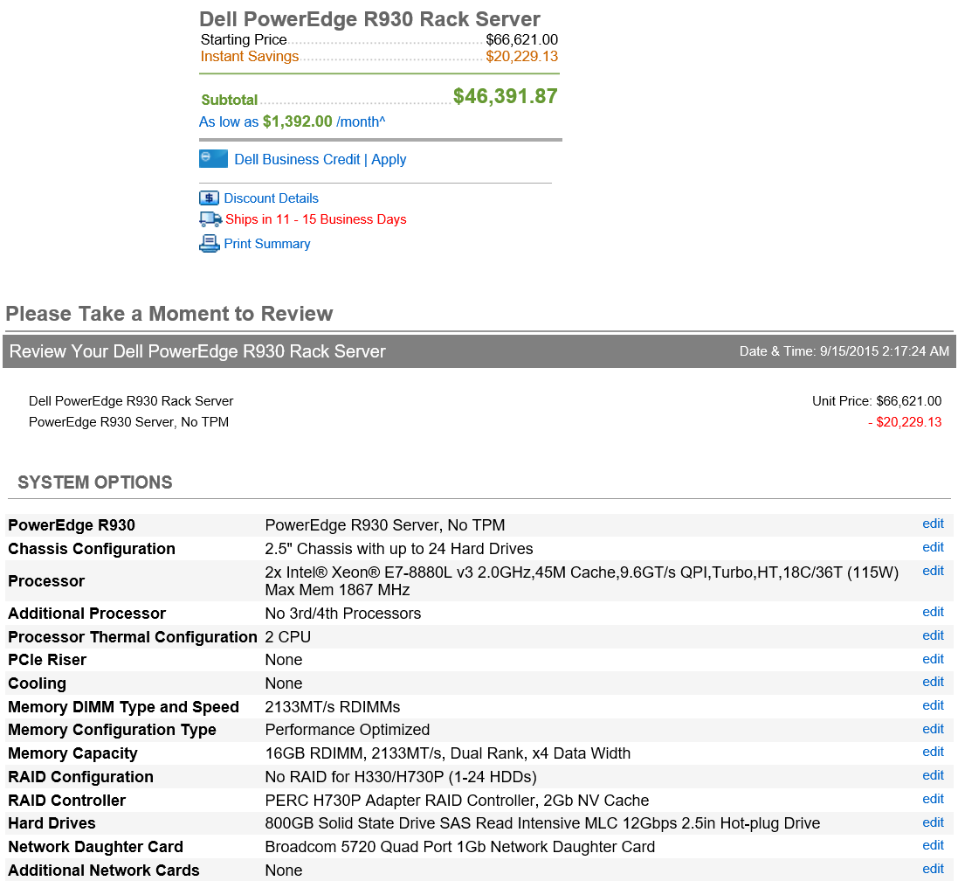
The G family
G
Optimized for data workloads
Up to 32 CPU cores, 448 GB RAM
6.5 TB local SSD
Latest generation Intel processor
Up to 64 attached disks!!

Slide 14
General Purpose Compute
Basic Tier
An economical option for development workloads, test servers, and other applications that don't require load balancing, auto-scaling, or memory-intensive virtual machines.
Instance | Cores | RAM | Disk sizes
A0 | 1 | 0.75 GB | 20 GB
A1 | 1 | 1.75 GB | 40 GB
A2 | 2 | 3.5 GB | 60 GB
A3 | 4 | 7 GB | 120 GB
A4 | 8 | 14 GB | 240 GB

Slide 15
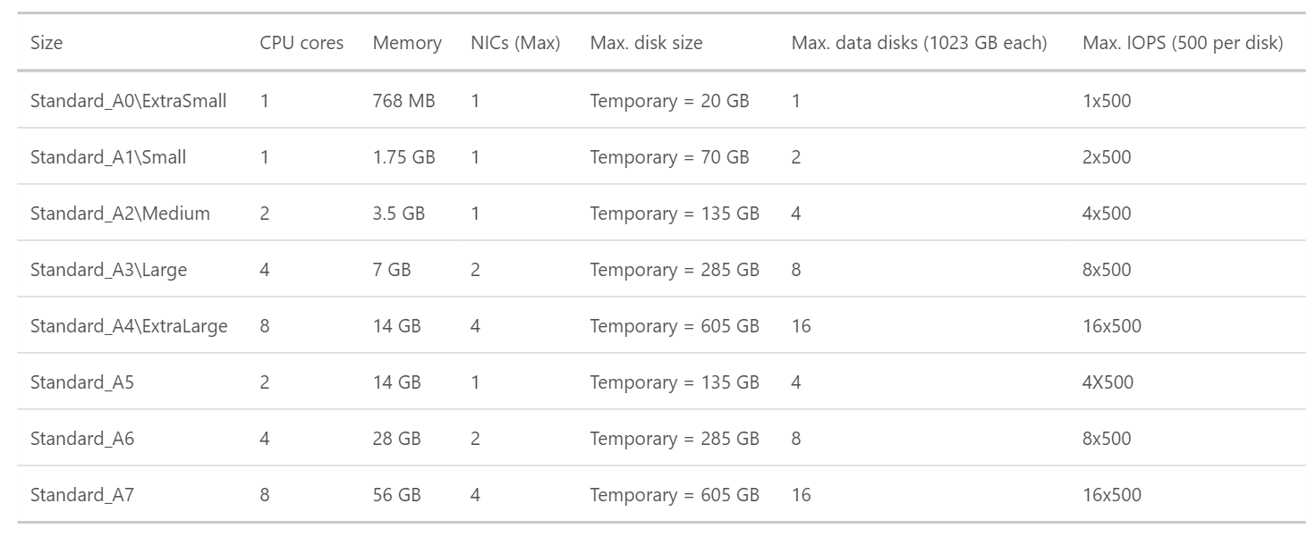
General Purpose Compute
Standard Tier
Offers the most flexibility. Supports all virtual machine configurations and features

Slide 16
General Purpose Compute
Network optimized with Infiniband support
Adds a 40Gbit/s InfiniBand network with remote direct memory access (RDMA) technology.
Instance | Cores | RAM | Disk sizes
A8 | 8 | 56 GB | 382 GB
A9 | 16 | 112 GB | 382 GB
Adds a 40Gbit/s InfiniBand network with remote direct memory access (RDMA) technology. Ideal for Message Passing Interface (MPI) applications, high-performance clusters, modeling and simulations, video encoding, and other compute or network intensive scenarios.
Notes:
This article provides background information and considerations for using the Azure A8, A9, A10, and A11 instances, also known as compute-intensiveinstances. Key features of these instances include:
High-performance hardware – The Azure datacenter hardware that runs these instances is designed and optimized for compute-intensive and network-intensive applications, including high-performance computing (HPC) cluster applications, modeling, and simulations.
RDMA network connection for MPI applications – When configured with the necessary network drivers, the A8 and A9 instances can communicate with other A8 and A9 instances over a low-latency, high-throughput network in Azure that is based on remote direct memory access (RDMA) technology. This feature can boost the performance of applications that use supported Linux or Windows Message Passing Interface (MPI) implementations.
Support for Linux and Windows HPC clusters – Deploy cluster management and job scheduling software on the A8, A9, A10, and A11 instances in Azure to create a stand-alone HPC cluster or to add capacity to an on-premises cluster. Like other Azure VM sizes, the A8, A9, A10, and A11 instances support standard or custom Windows Server and Linux operating system images or Azure Resource Manager templates in Azure VMs (IaaS), or Azure Guest OS releases in cloud services (PaaS, for Windows Server only).
NOTE:
A10 and A11 instances have the same performance optimizations and specifications as the A8 and A9 instances. However, they do not include access to the RDMA network in Azure. They are designed for HPC applications that do not require constant and low-latency communication between nodes, also known as parametric or embarrassingly parallel applications.

Slide 17
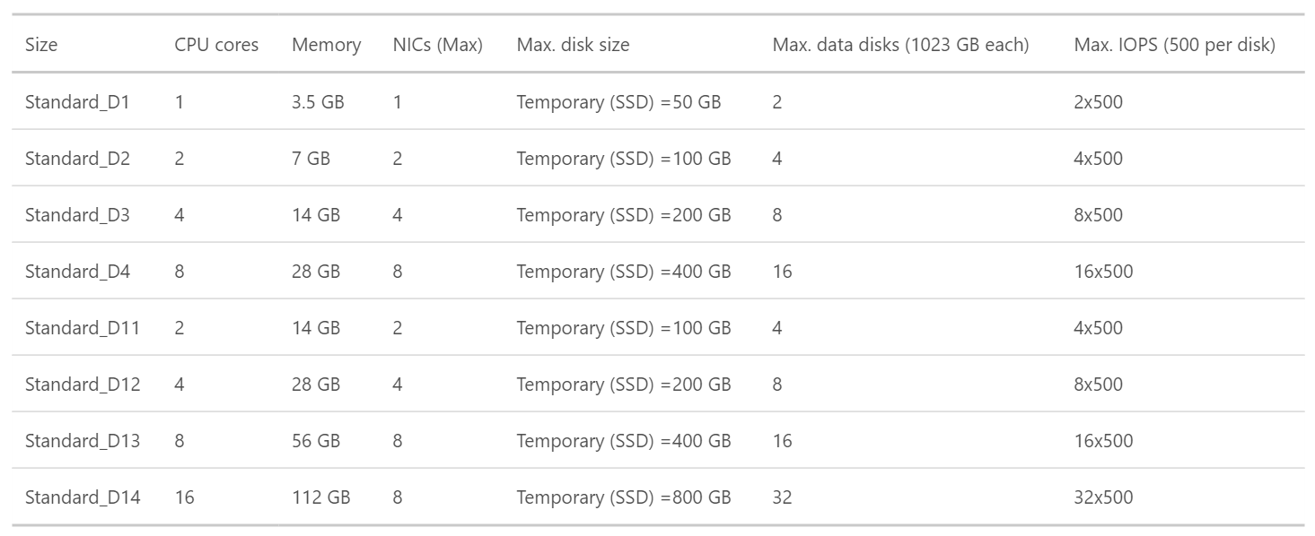
Optimized Compute (D Tier)- 60% faster CPUs, more memory, and local SSD

Slide 18
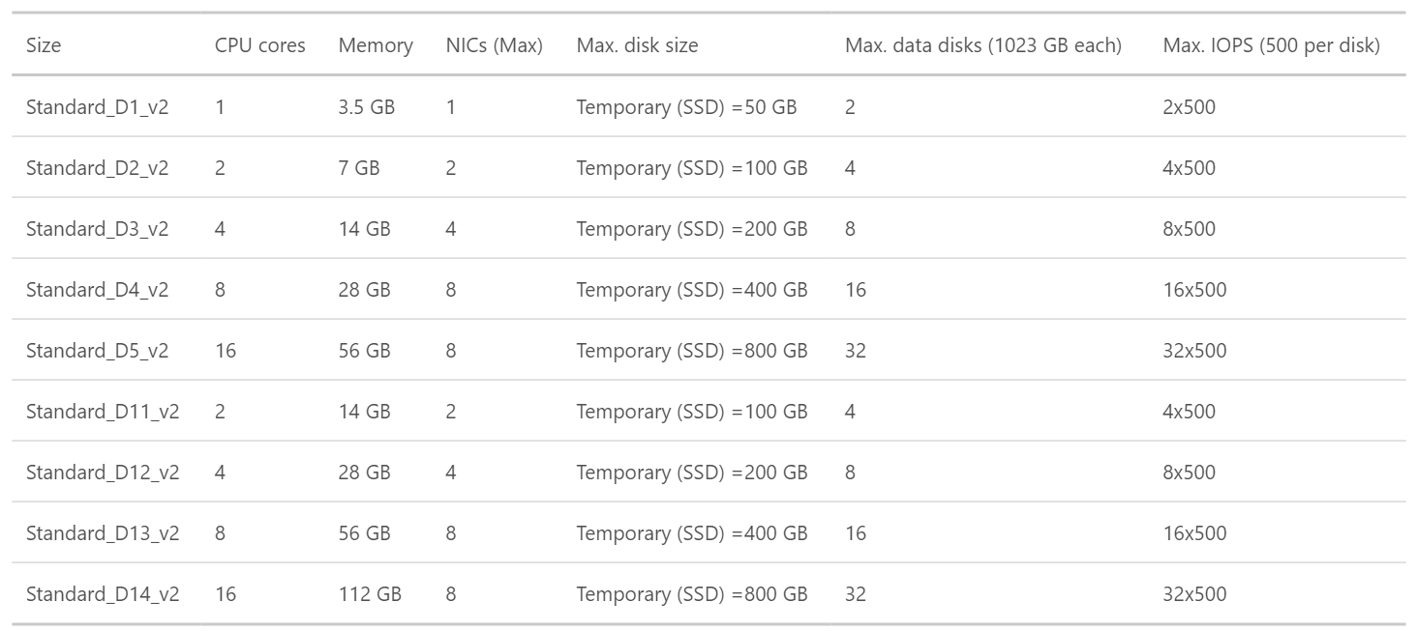
Dv2 Series- 35% faster than D series, 2.4 GHz Intel Xeon® E5-2673 v3 (Haswell) processor
Notes:
Dv2-series, a follow-on to the original D-series, features a more powerful CPU. The Dv2-series CPU is about 35% faster than the D-series CPU. It is based on the latest generation 2.4 GHz Intel Xeon® E5-2673 v3 (Haswell) processor, and with the Intel Turbo Boost Technology 2.0, can go up to 3.2 GHz. The Dv2-series has the same memory and disk configurations as the D-series.

Slide 19
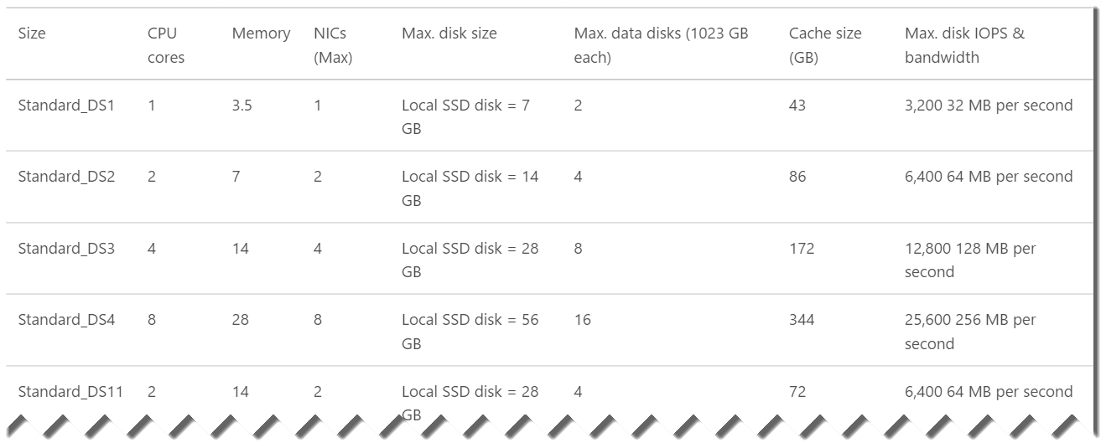
DS-series VMs can use Premium Storage- high-performance, low-latency storage.
Notes:
DS-series and GS-series VMs can use Premium Storage, which provides high-performance, low-latency storage for I/O intensive workloads. These VMs use solid-state drives (SSDs) to host a virtual machine’s disks and also provide a local SSD disk cache. Premium Storage is available in certain regions.

Slide 20
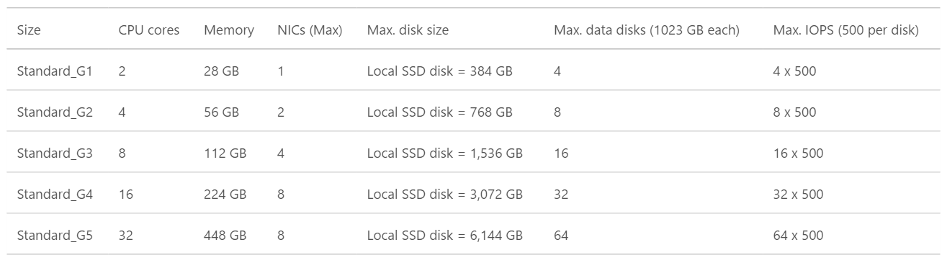
G-series VMs offer the most memory and run on hosts that have Intel Xeon E5 V3 family processors.

Slide 21
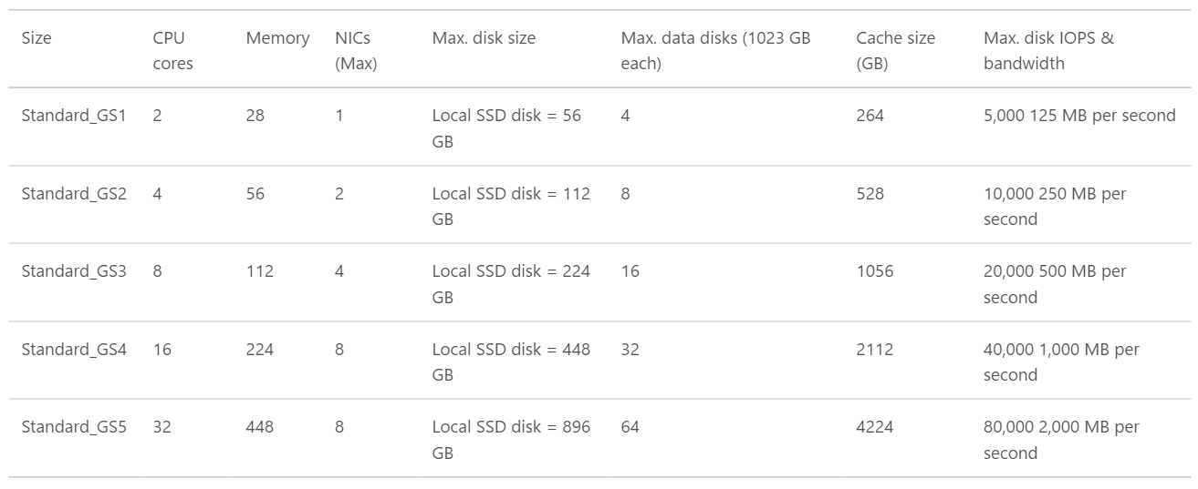
GS-series VMs , Godzilla ++ (Premium Storage- high-performance, low-latency storage for I/O intensive workloads.)

Slide 22
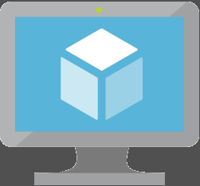
Key Improvements: Azure Virtual Machines (v2)
Massive and parallel deployment of Virtual Machines
3 Fault Domains in Availability Sets
Custom URLs for Custom Script VM Extensions for VMs
https://azure.microsoft.com/en-us/documentation/articles/virtual-machines-app-frameworks/

Slide 23
Demo: Managing VMs using Azure portal
Notes:
Demo: Provisioning VM
Prerequisites:
A Windows Server 2012 is already provisioned.
Steps:
Open Ibiza portal and click the NEW button at the lower-left corner.
Show the short list of resources. Explain that I can directly create popular resources here such as a Windows Server 2012.
Click on the Everything link.
In Gallery blade, open the Virtual machines category.
Scroll down the view and show images of different types (refer back to slide 9).
Click on Windows Server 2012 R2, and then click the Create button in the overview blade. For non-Microsoft focused audience, consider to pick a Linux image instead.
Fill in the Create VM form and click on the Create button to provision the VM. Explain this will take a few minutes.
Open the already provisioned VM.
Scroll down the blade to show various of information available on the blade.
Click on the Extensions tile.
On the Extensions blade, click on the ADD icon to bring up the extension list. Introduce that VM extensions are installable components to customize VM instances.
Switch to slides to continue with VM extension introduction.

Slide 24
Image Mobility
On-Premises
Cloud
MyApp.vhd
Notes:
Slide Objective:
Explain the benefits of image mobility
Notes:
One of the key benefits of IaaS is flexibility and control. The Microsoft Azure solution provides the capability of not only moving VHDs TO the cloud but also allows you to copy the VHD back down and run it locally or on another cloud provider. Great for testing out production issues or any other need where you require a copy of the production server.

Slide 25
Data Persistence
OS Disks
Data Disks

Slide 26
Disks and Images
OS Images
Microsoft
Partner
User
Base OS image for new Virtual Machines
Sys-Prepped/Generalized/Read Only
Created by uploading or by capture
Disks
OS Disks
Data Disks
Writable Disks for Virtual Machines
Created during VM creation or during upload of existing VHDs.
Notes:
Slide Objective:
Explain the differences between disks and images with VMs

Slide 27
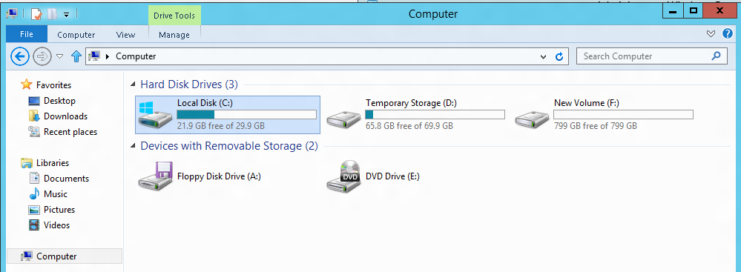
VM disk layout
OS Disk
Persistent
SATA
Drive C:
Temporary Storage Disk
Local (Not Persistent)
SATA
Drive D:
Data Disk(s)
Persistent
SCSI
Customer Defined Letter

Slide 28
Temporary Drive Guidance
Never Place Critical Unreplicated Data on Temp Drive!!
Use for SQL TempDB and Buffer Pool Extension on D-Series and G-Series VM Sizes Only (SSD Temp Disks)
Detailed instructions: http://blogs.technet.com/b/dataplatforminsider/archive/2014/09/25/using-ssds-in-azure-vms-to-store-sql-server-tempdb-and-buffer-pool-extensions.aspx
Use Scheduled Tasks to Configure Temporary Disk
Test Scheduled Tasks via Resize VM Operation

Slide 29
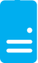
Persistent Disks and Highly Durable
Microsoft Azure Storage (Disaster Recovery)
Microsoft Azure Storage
Virtual
Machine
Virtual Machine
Notes:
Slide Objective:
Explain how disks are durable and how Microsoft Azure storage works
Notes:
The OS and Data Disks are stored in Microsoft Azure storage. So in addition to the data being persistent you also get the benefits of storage which means your VHD is replicated 3X’s locally and also 3X’s in a separate data center in the same region (geo-replication)

Slide 30
Demo: Storages and Disks
Notes:
Demo: Provisioning VM
Prerequisites:
A Windows Server 2012 is already provisioned.
Steps:
Open Ibiza portal and click the NEW button at the lower-left corner.
Show the short list of resources. Explain that I can directly create popular resources here such as a Windows Server 2012.
Click on the Everything link.
In Gallery blade, open the Virtual machines category.
Scroll down the view and show images of different types (refer back to slide 9).
Click on Windows Server 2012 R2, and then click the Create button in the overview blade. For non-Microsoft focused audience, consider to pick a Linux image instead.
Fill in the Create VM form and click on the Create button to provision the VM. Explain this will take a few minutes.
Open the already provisioned VM.
Scroll down the blade to show various of information available on the blade.
Click on the Extensions tile.
On the Extensions blade, click on the ADD icon to bring up the extension list. Introduce that VM extensions are installable components to customize VM instances.
Switch to slides to continue with VM extension introduction.

Slide 31
Linux on the
Microsoft Cloud Platform

Slide 32
Microsoft Linux

Slide 33
Microsoft is committed to Linux and open source
Linux is a real business for Microsoft
25% of IaaS VMs in Azure are Linux
System Center manages hundreds of thousands of Linux/UNIX servers
Many enterprises and service providers
run Linux as a guest on Hyper-V
… and we’re been in a long open source journey!
System Center has managed Linux and
UNIX servers since 2009
Linux drivers for Hyper-V available since 2010
Azure IaaS has run
Linux VMs since
“day 1” in 2013
Linux and open source are a fundamental part of how we do business
Today

Slide 34
Demo: Linux on Azure
Notes:
Demo: Provisioning VM
Prerequisites:
A Windows Server 2012 is already provisioned.
Steps:
Open Ibiza portal and click the NEW button at the lower-left corner.
Show the short list of resources. Explain that I can directly create popular resources here such as a Windows Server 2012.
Click on the Everything link.
In Gallery blade, open the Virtual machines category.
Scroll down the view and show images of different types (refer back to slide 9).
Click on Windows Server 2012 R2, and then click the Create button in the overview blade. For non-Microsoft focused audience, consider to pick a Linux image instead.
Fill in the Create VM form and click on the Create button to provision the VM. Explain this will take a few minutes.
Open the already provisioned VM.
Scroll down the blade to show various of information available on the blade.
Click on the Extensions tile.
On the Extensions blade, click on the ADD icon to bring up the extension list. Introduce that VM extensions are installable components to customize VM instances.
Switch to slides to continue with VM extension introduction.

Slide 35
Virtual Machine Availability
Meaning of 9’s
Fault domains, update domains and availability sets
Load balancing

Slide 36
Meaning of 9’s
Service Availability(%) | System Type | Annualized Down Minutes | Quarterly Down Minutes | Monthly Down Minutes | Practical Meaning | FAA rating
90 | Unmanaged | 52,596.00 | 13,149.00 | 4,383.00 | Down 5 weeks per year
99 | Managed | 5,259.60 | 1,314.90 | 438.30 | Down 4 days per year | ROUTINE
99.9 | Well managed | 525.96 | 131.49 | 43.83 | Down 9 hours per year | ESSENTIAL
99.99 | Fault tolerant | 52.60 | 13.15 | 4.38 | Down 1 hour per year
From Generic Requirements for Operation Systems Platform Reliability, Telcordia Technologies System Documentation,GR-2841-CORE and
Federation Aviation Administration Handbook: Reliability, Maintainability, and Availability (RMA) Handbook, FAA-HDBK-006A, Jan 7, 2008.
Microsoft Azure

Slide 37
Meaning of 9’s
Service Availability(%) | System Type | Annualized Down Minutes | Quarterly Down Minutes | Monthly Down Minutes | Practical Meaning | FAA rating
99.999 | High availability | 5.26 | 1.31 | 0.44 | Down 5 minutes per year | CRITICAL
99.9999 | Very high availability | 0.53 | 0.13 | 0.04 | Down 30 seconds per year
99.99999 | Ultra availability | 0.05 | 0.01 | - | Down 3 seconds per year | SAFETY CRITICAL
From Generic Requirements for Operation Systems Platform Reliability, Telcordia Technologies System Documentation,GR-2841-CORE and
Federation Aviation Administration Handbook: Reliability, Maintainability, and Availability (RMA) Handbook, FAA-HDBK-006A, Jan 7, 2008.
Microsoft Azure

Slide 38

Service Level Agreements
99.95% for multiple role instances
4.38 hours of downtime per year
What’s included
Compute Hardware failure (disk, CPU, memory)
Datacenter failures - Network failure, power failure
Hardware upgrades, Software maintenance – Host OS Updates
What is not included
VM Container crashes, Guest OS Updates

Slide 39

Availability Sets
Availability set
SLA High Availability
Hardware and Software
Windows and Linux
Virtual Machine
Virtual Machine
SQL Server
Primary
SQL Server
Secondary
SLA 99.95

Slide 40
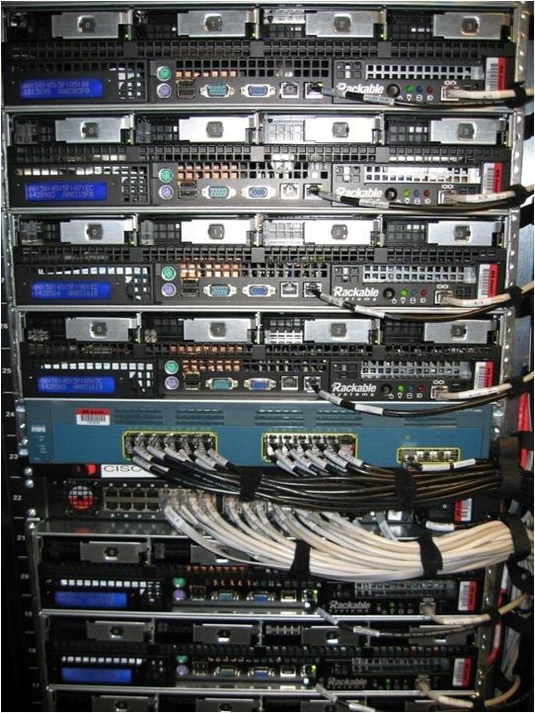
Availability Sets
Physical Machines
Power Unit
Rack Switch

Slide 41

Availability Sets
Physical Machines
Power Unit
Rack Switch
VM1
VM2
VM2
VM1
VM2
Availability Set

Slide 42
Fault and Update Domains
Fault Domain
Fault Domain
Rack
Rack
Web Role
UD #1
UD #2
INSTANCE
INSTANCE
INSTANCE
INSTANCE
Worker Role
UD #1
UD #2
INSTANCE
INSTANCE
INSTANCE
INSTANCE
Notes:
Slide Objective:
Provide a graphical view of fault and upgrade domains for existing web and worker roles. Use to contrast existing skills with availability sets.
Notes:
You can see that our service is well spread out across both fault and upgrade domains
The loss of a fault domain will not cause a failure of our service nor will the restart or change of an upgrade domain cause a failure of our service
Notes
Useful pre-reading here.
http://blog.toddysm.com/2010/04/upgrade-domains-and-fault-domains-in-windows-azure.html

Slide 43
Virtual Machine Availability Sets
Update Domains are honored by host OS updates
Fault Domain
Fault Domain
Rack
Rack
Availability Set
Virtual Machine
Virtual Machine
IIS1
IIS2
UD #1
UD #2
Availability Set
Virtual Machine
Virtual Machine
SQL1
SQL2
UD #1
UD #2
Notes:
Slide Objective:
Explain availability sets
Notes:
Availability sets tell the Fabric Controller to place VMs in the same set on different racks for faults and in separate upgrade domains for updates.
This essentially tells the FC not to take the guest OS down of all VMs in the same set for host updates.

Slide 44
Availability Set Guidance
VMs in Availability Set Must Be in Same Resource Group
Availability Set: 5 Update Domains, 3 Fault Domains
Update Domain – Host Maintenance
Fault Domain – Isolation from component failure in rack unit
Maximum of 100 VMs in a Availability Set
Avoid Availability Sets with Single VM
This eliminates notification for host maintenance operations
https://azure.microsoft.com/en-us/documentation/articles/azure-subscription-service-limits/

Slide 45
Demo: Availability Sets
Notes:
Demo: Provisioning VM
Prerequisites:
A Windows Server 2012 is already provisioned.
Steps:
Open Ibiza portal and click the NEW button at the lower-left corner.
Show the short list of resources. Explain that I can directly create popular resources here such as a Windows Server 2012.
Click on the Everything link.
In Gallery blade, open the Virtual machines category.
Scroll down the view and show images of different types (refer back to slide 9).
Click on Windows Server 2012 R2, and then click the Create button in the overview blade. For non-Microsoft focused audience, consider to pick a Linux image instead.
Fill in the Create VM form and click on the Create button to provision the VM. Explain this will take a few minutes.
Open the already provisioned VM.
Scroll down the blade to show various of information available on the blade.
Click on the Extensions tile.
On the Extensions blade, click on the ADD icon to bring up the extension list. Introduce that VM extensions are installable components to customize VM instances.
Switch to slides to continue with VM extension introduction.

Slide 46
Load balancing
Load balancing
Multiple VMs share the workload via public facing endpoints
Internal Load balancing
Load balancing between VMs that don’t have public facing endpoints
Microsoft Azure
Internet
Public VIP
Customer vNet
External Load Balancer
Internal Load Balancer
Microsoft Azure
Back end
Front end

Slide 47
Traffic Manager
Load balancing
Failover
US West
North Europe
Microsoft Azure
North America
Europe

Slide 48
Virtual Networks

Slide 49
Azure Virtual Networks
A protected private virtual network in cloud
Extend enterprise networks into Azure
Cross-premises connectivity

Slide 50
Virtual Network Scenarios
Hybrid Public/Private Cloud
Enterprise app in Microsoft Azure requiring connectivity to on-premise resources
Enterprise Identity and Access Control
Manage identity and access control with on-premise resources (on-premises Active Directory)
Monitoring and Management
Remote monitoring and trouble-shooting of resources running in Azure
Advanced Connectivity Requirements
Cloud deployments requiring IP addresses and direct connectivity across services
Microsoft Azure

Slide 51






Cross-premises Connectivity
Site-to-site
Create a secure connection between your on-premises site and your virtual network
Point-to-site
Create a secure connection via VPN to your virtual network
ExpressRouteTM
Create a private connection between Azure data centers and infrastructures on your premises or in a co-location environment.
Connect at an ExpressRoute location (Exchange Provider facility)
Direct connect via a Network Service Provider
Microsoft Azure

Slide 52
Azure Stack (Azure on premise)

Slide 53
Azure Stack – Intro
Install Azure to build your own cloud
Available only with Windows Server 2016 Datacenter Edition Technical Preview 4 PoC
https://azure.microsoft.com/en-us/documentation/azure-stack/
Minimal requirements:
1 Server
12 Cores
1 Disk OS + 4 separate Disks
96GB RAM / 128GB RAM
Microsoft Azure

Slide 54
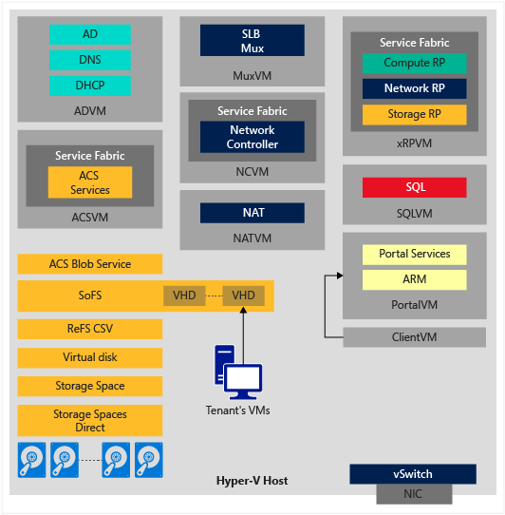
Azure Stack – Architecture
Microsoft Azure

Slide 55
Final Thoughts
Cloud Adoption is a Must
But connectivity and pricing must be carefully calculated.
Azure is growing ! (rough childhood)
Fast / Learning from the others (AWS / Google)
Although, Usability is nice on the new portal is not 100%.
Some resources are only managed by Classic Portal / Powershell
Microsoft Azure

Slide 56


Questions ?
Thanks

